Slide 1



DATA EXPLORATION
Berlian Rahmy Lidiawaty, S.ST., M.MT.
Information Systems Undergraduate Program School of Industrial Engineering

Slide 2
PLO & CLO to be achieved:
PLO01 – Able to analyze complex INFOKOM issues, defining and modeling requirements in the context of enterprises or society by applying knowledge in the fields of computing, information and communication technology, and other relevant disciplines
CLO07 – Students are able to apply fundamental statistical knowledge in the scope of information systems science

Slide 3
ISLP_website-1.pdf
Outline:
Types of Data and Measurement Scale
Sampling Techniques
Statistics of Data
Data Visualization
Reference:
James, Gareth et al. 2023. An Introduction Statistical Machine Learning With Applications in Python. Springer
Walpole, Ronald E., Myers, Raymond H., Myers, Sharon L. 2013. Probability & Statistics for Engineers & Scientists. 9th ed.. Pearson Education. United States of America

Slide 4
Types of Data & Measurement Scale

Slide 5
Data can be defined as:
A factual information
Things known or assumed as facts based on observation, experiments or measurements, making the basis of reasoning or calculation
Data attribute is any general characteristic or property that can be associated with a specific collection of data. Data attribute can be defined as variable or feature
A data object is a structure for describing a data entity by grouping a set of related fields.
Example:
Sales data: customer identity, quantity of product, name or category of product, number of sales
Medical record data: patient identity, medical condition, medication, blood test result

Slide 6
Data
Qualitative
Nominal
Ordinal
Quantitative
Discrete
Continuous

Slide 7
Data Classification

Slide 8
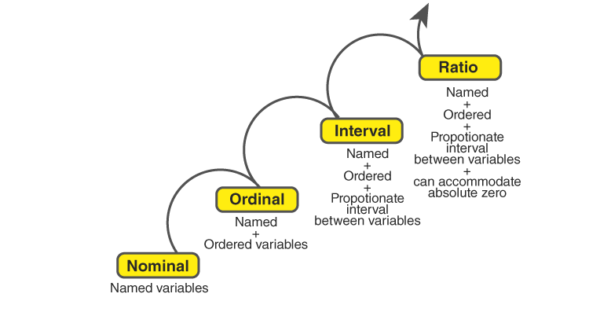
Measurement Scale

Slide 9
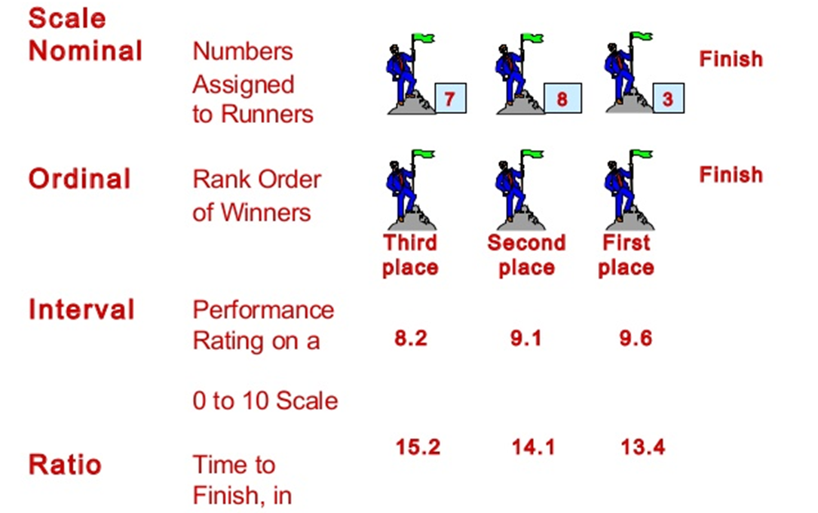
Measurement Scale

Slide 10
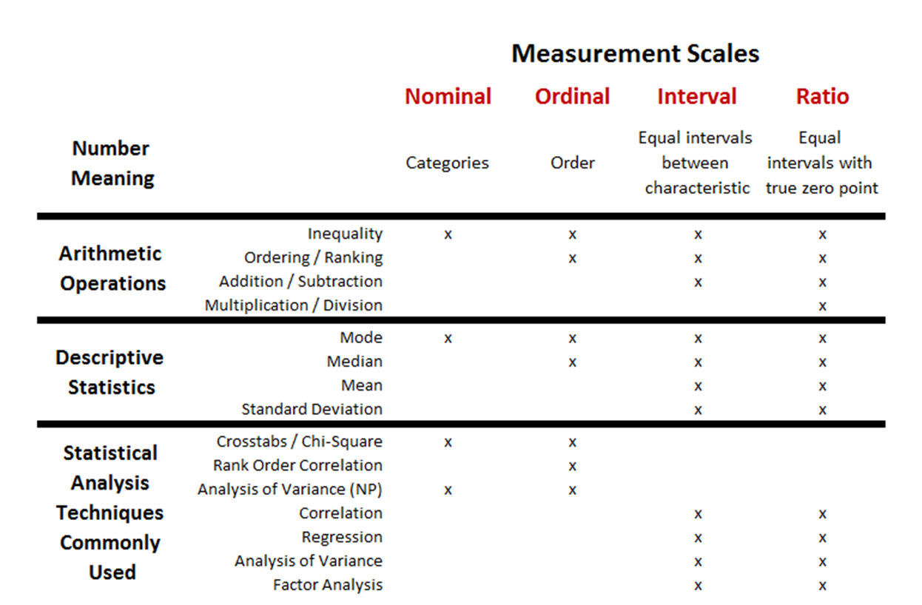
Measurement Scale

Slide 11
Sampling Technique

Slide 12
Sampling Technique
Probability
Technique
Census
Sampling
Primary
Secondary

Slide 13
Sampling Techniques
Random Sampling -> each member of the population has an equal chance of being selected
Stratified Sampling -> The population is divided into different subgroups or strata, and random samples are taken from each stratum in proportion to their representation in the dataset.
Cluster Sampling -> The population is divided into clusters, and entire clusters are randomly selected for sampling
Systemic Sampling -> A sample is selected based on a fixed periodic interval
Undersampling (for imbalanced data) -> reduce the number of samples from the majority class to create a more balanced dataset.
Oversampling (for imbalanced data) -> Data from the minority class is oversampled to balance the dataset

Slide 14
Statistics of Data

Slide 15
Statistics of Data
Measures of Central Tendency
Measures of Dispersion

Slide 16
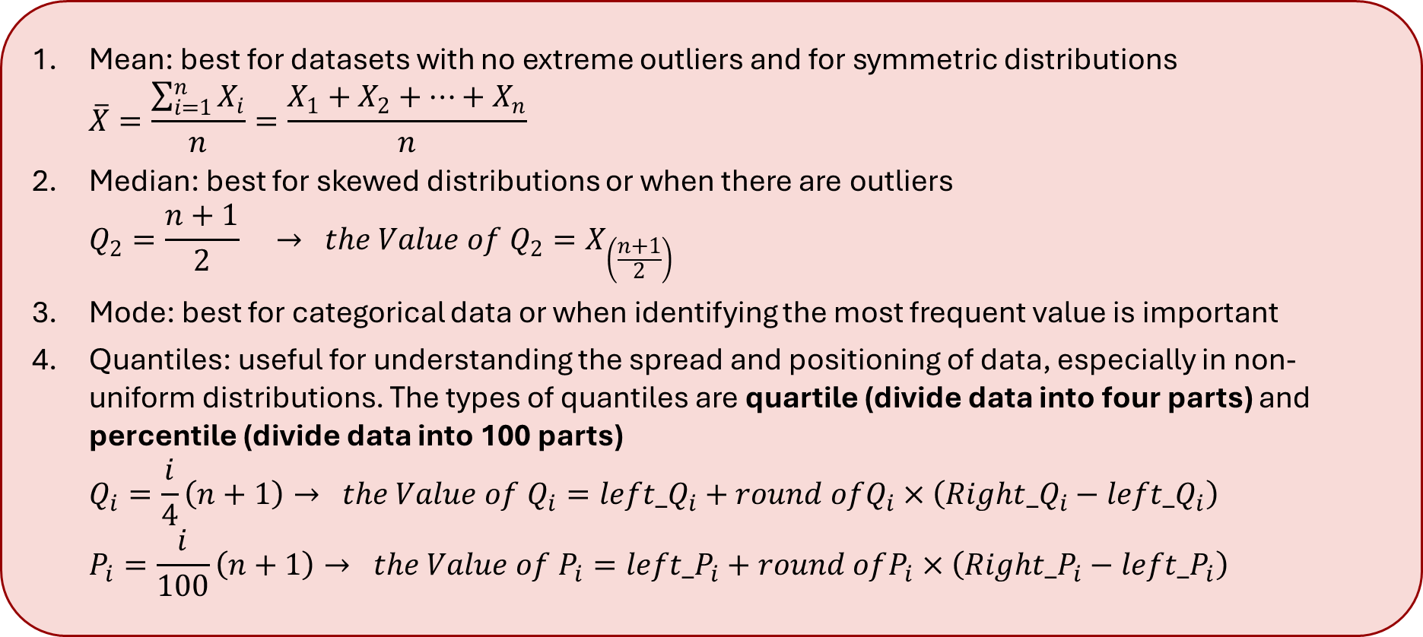
Measures of Central Tendency
Mean: best for datasets with no extreme outliers and for symmetric distributions
$$\overline{X}=\frac{\sum_{i=1}^{n}{X_{i}}}{n}=\frac{X_{1}+X_{2}+⋯+X_{n}}{n}$$
Median: best for skewed distributions or when there are outliers
$$Q_{2}=\frac{n+1}{2} → the Value of{ Q}_{2}=X_{\left(\frac{n+1}{2}\right)}$$
Mode: best for categorical data or when identifying the most frequent value is important
Quantiles: useful for understanding the spread and positioning of data, especially in non-uniform distributions. The types of quantiles are quartile (divide data into four parts) and percentile (divide data into 100 parts)
$$Q_{i}=\frac{i}{4}\left(n+1\right)→ the Value of{ Q}_{i}=left_Q_{i}+round ofQ_{i}×\left(Right{_Q}_{i}−left_Q_{i}\right) \\ P_{i}=\frac{i}{100}\left(n+1\right)→ the Value of{ P}_{i}=left_P_{i}+round ofP_{i}×\left(Right{_P}_{i}−left_P_{i}\right)$$

Slide 17
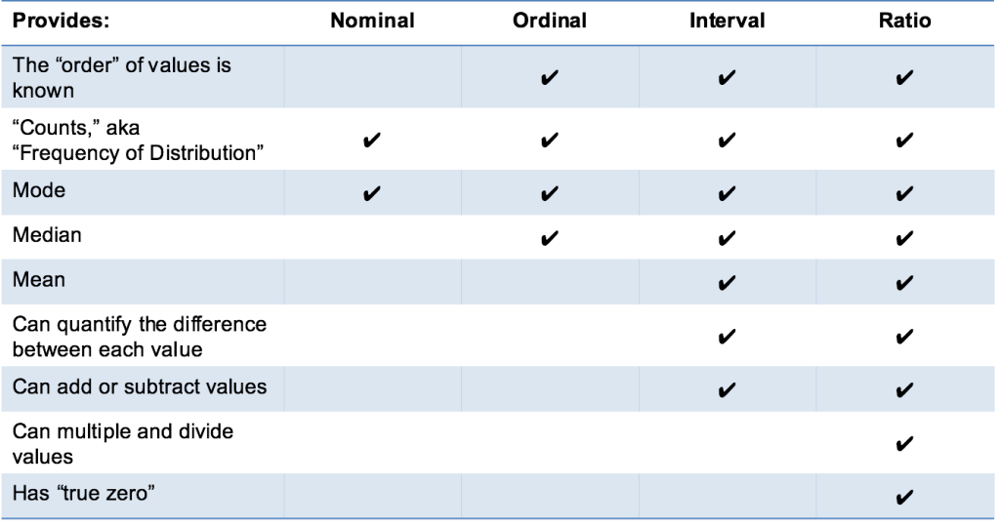

Slide 18
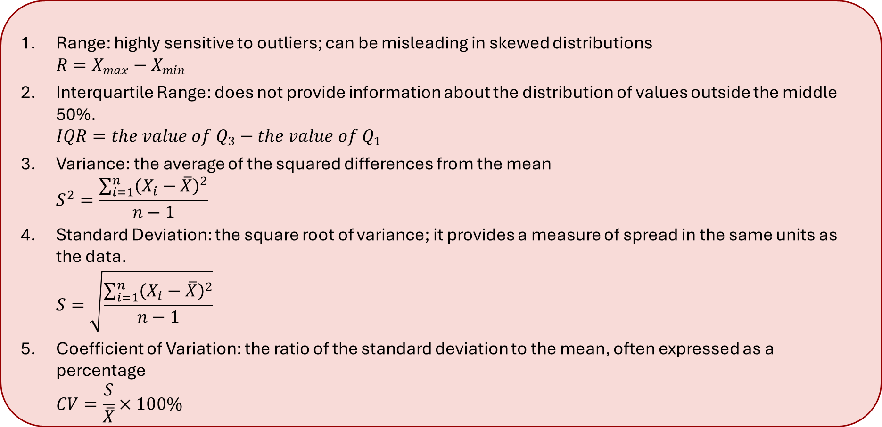
Measures of Dispersion
Range: highly sensitive to outliers; can be misleading in skewed distributions
$$R=X_{max}−X_{min}$$
Interquartile Range: does not provide information about the distribution of values outside the middle 50%.
$$IQR=the value of Q_{3}−{the value of Q}_{1}$$
Variance: the average of the squared differences from the mean
$$S^{2}=\frac{\sum_{i=1}^{n}{{\left(X_{i}−\overline{X}\right)}^{2}}}{n−1}$$
Standard Deviation: the square root of variance; it provides a measure of spread in the same units as the data.
$$S=\sqrt{\frac{\sum_{i=1}^{n}{{\left(X_{i}−\overline{X}\right)}^{2}}}{n−1}}$$
Coefficient of Variation: the ratio of the standard deviation to the mean, often expressed as a percentage
$$CV=\frac{S}{\overline{X}}×100\%$$

Slide 19
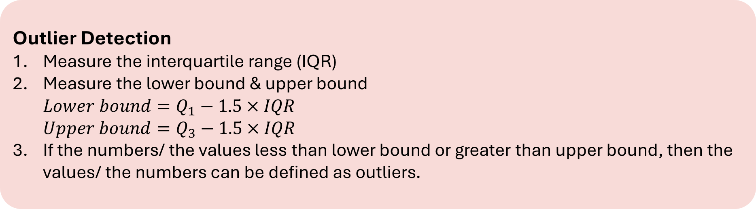
Outlier Detection
Measure the interquartile range (IQR)
Measure the lower bound & upper bound
$${Lower bound=Q}_{1}−1.5×IQR \\ {Upper bound=Q}_{3}−1.5×IQR$$
If the numbers/ the values less than lower bound or greater than upper bound, then the values/ the numbers can be defined as outliers.

Slide 20
Data Visualization

Slide 21
Bar Chart
Bar chart: vertical or horizontal bars represent data points in different categories that use

Slide 22
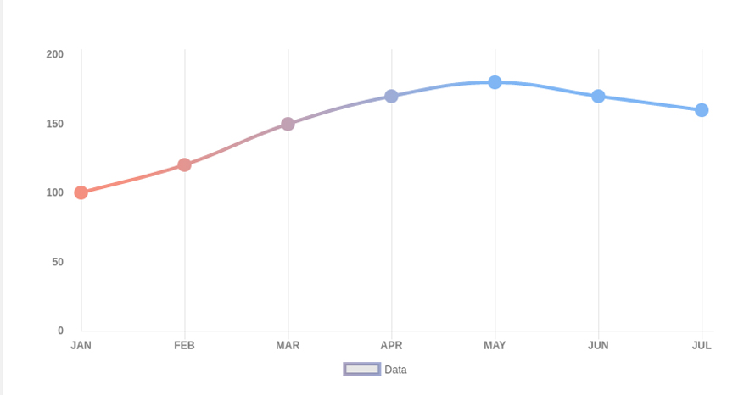
Line Chart
Line chart: a line connects individual data points to show changes over time

Slide 23
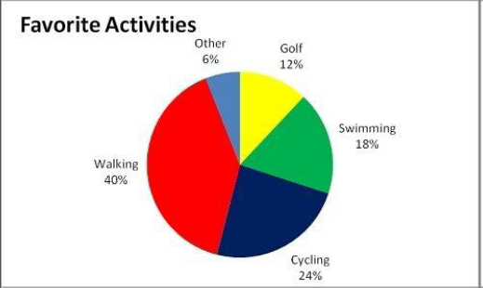
Pie Chart
Pie chart: a circular chart divided into sectors, where each sector represents a portion of the total

Slide 24
Box Plot
Box Plot (Box-and-Whisker Plot): a graph that visually summarizes the distribution of a dataset by showing its central tendency and variability, as well as potential outliers.

Slide 25
Histogram
Histogram is vertical bars showing the frequency of data points in different ranges. Histogram can detect a distribution of dataset

